Slide 1



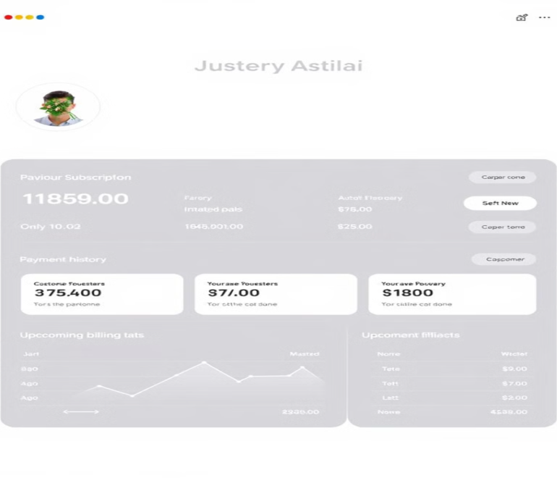
Integrated Subscription Billing with Stripe
Presented By
Sanmathi.S
Sarojadevi.p

Slide 2

Integrated Subscription Billing with Stripe
Stripe offers a robust subscription billing solution that seamlessly integrates into your platform. From managing customer subscriptions to handling recurring payments, Stripe streamlines the process, allowing you to focus on building your core business.

Slide 3
Understanding Stripe's Subscription
Billing Capabilities
Subscription Plans
Customer Management
Stripe allows you to define various subscription plans with different pricing tiers, features, and billing cycles.
You can easily manage customer subscriptions, update billing information, and track payment history.
Automated Billing and Payment Processing
Stripe automates recurring billing, ensuring timely payments and eliminating manual processes.

Slide 4

Importance of Subscription Billing in Today's Economy
1.Predictable Revenue
Subscription billing provides predictable revenue streams, allowing for long-term financial planning.
2.Customer Retention
Recurring payments encourage customer loyalty and retention, building a strong foundation for long-term growth.
3.Improved Customer Experience
Subscription models offer convenience and flexibility, enhancing customer satisfaction and building brand loyalty.

Slide 5
Key Features of Stripe Subscriptions
Customizable Billing Cycles
Multiple Payment Methods
Offer flexible billing cycles, allowing customers to choose their preferred payment frequency.
Accept various payment methods, including credit cards, debit cards, and digital wallets, for seamless transactions.
Trial Periods
Offer trial periods to encourage sign-ups and give customers a chance to experience your product or service.

Slide 6

Integrating Stripe Subscriptions into Your Platform
API Integration
Stripe's comprehensive API makes integrating subscription billing into your existing platform a straightforward process.
Checkout Optimization
Customize Stripe's checkout experience to match your brand aesthetics and streamline the payment process.
Customer Account Management
Allow customers to manage their subscription details, payment methods, and billing information within your platform.

Slide 7
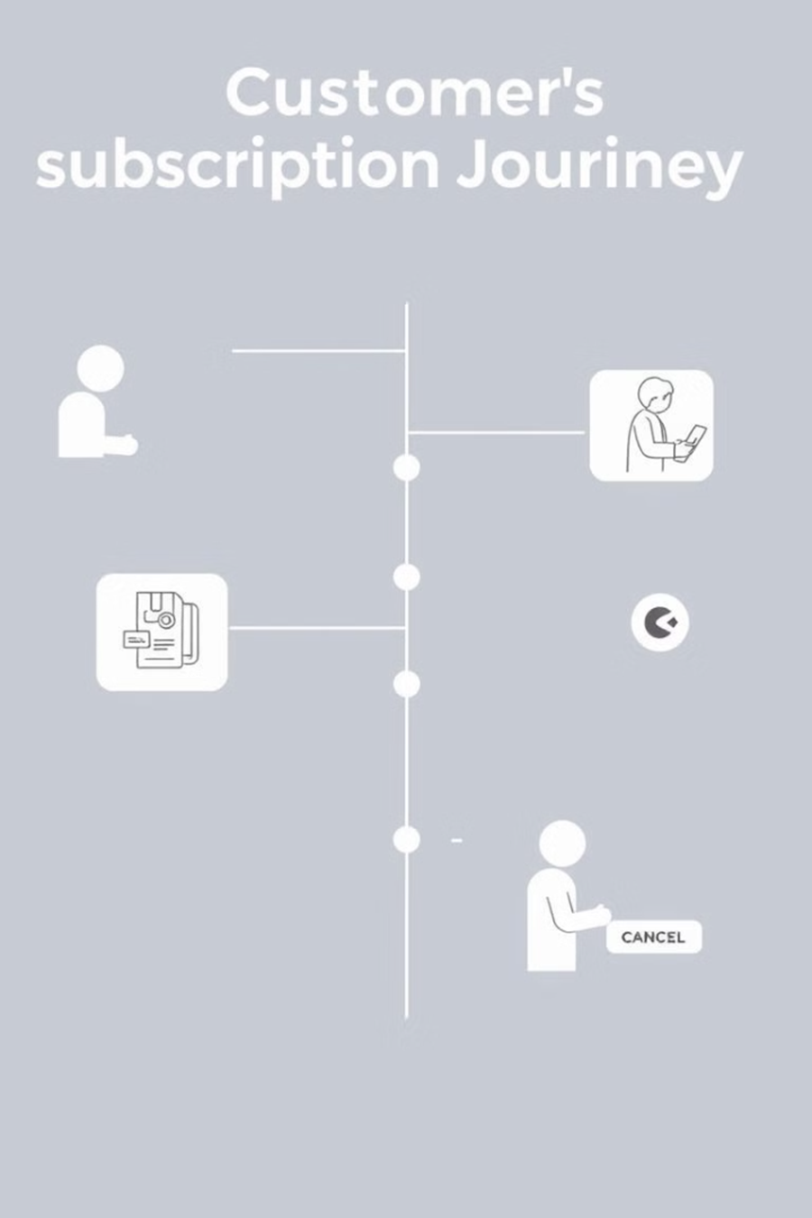
Managing Subscription Lifecycle and Customer Data
1
Subscription Activation
Upon sign-up, activate customer subscriptions and process the first payment.
2
Recurring Billing
Automate recurring payments based on the defined billing cycles and track payment history.
3
Subscription Management
Enable customers to update their subscription plans, change payment methods, or cancel their subscriptions.
4
Customer Support
Provide dedicated support channels for customers to address any subscription-related queries or issues.

Slide 8

Optimizing Subscription Checkout and Payment Flows
Ensure Payment Security
Use Stripe's robust security measures to safeguard sensitive customer data.
Offer Localized Options
Support multiple currencies and languages to cater to a global audience.
Simplify the Checkout Process
Minimize the number of steps required for a seamless checkout experience.
Optimize for Mobile Devices
Design responsive checkout pages that work flawlessly on all devices.

Slide 9
Best Practices and Lessons Learned
Clearly Define Subscription Plans
Communicate plan features and benefits to customers.
Offer Flexible Billing Options
Allow customers to choose their preferred billing frequency and payment methods.
Prioritize Customer Support
Provide responsive and personalized support for subscription-related queries.
Analyze Customer Data
Track key metrics and customer behavior to identify areas for improvement and optimize your subscription model.

Slide 10


